Slide 1

Good morning

Slide 2
Instance Based Learning
Parametric
Naïve Bayes
MLE
Non-parametric
k Nearest Neighbour Learning(kNN)
Locally weighted regression(LWR)
Radial Basis Functions (RBF)

Slide 3
knn
KNN is a non-parametric, lazy learning algorithm based on feature similarity.
Algorithm
Step1: Select a number k with every new instance.
Step2: Find the distance between the new instance and the stored data to find out the k closest ones.
Step3: From the selected k closest ones, find the most common class and assign that to the new instance.
Note: Distance Measure, Interpolation

Slide 4
Knn-Distances
Distance (similarity) measure - value indicating how similar data points are .
Distances:
for all objects x_{i},B, dist(x_{i}, x_{j}) ≥ 0, dist(x_{i}, x_{j})=dist(x_{j}, x_{i})
for any object x_{i}, dist(x_{i}, x_{i}) = 0
dist(x_{i}, x_{j}) ≤ dist(x_{i}, x_{k}) + dist(x_{k}, x_{j})

Slide 5
Knn-Distances
Distance measures:
The vectors(instances) are assumed to be present in an Euclidean space like .
Euclidean:

Slide 6
knn
In this method, all training examples are stored. Whenever a query instances arrives, it is compared with every stored for the distance and based on chosen k, a local group is arrived at before interpolation.
So, the issues are storing, retrieving, distance calculation , speed.
Another major issue is that the Distance is based on all the attributes/features of the instance. When we have a large number of features and if only a few are relevant, we could have errors. This is termed as Curse of Dimensionality.
Curse of Dimensionality is addressed sometimes by weighting the axes using validation methods.

Slide 7
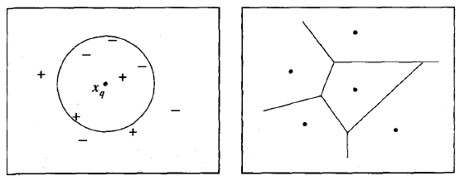
knn
KNN is a non-parametric, lazy learning algorithm based on feature similarity.
The shape of this decision surface induced by 1-NEAREST NEIGHBOUR over the entire instance space.
The decision surface is a combination of convex polyhedra surrounding each of the training examples.
For every training example, the polyhedron indicates the set of query points whose classification will be completely determined by that training example.
Query points outside the polyhedron are closer to some other training example. This kind of diagram is often called the Voronoi diagram of the set of training examples

Slide 8
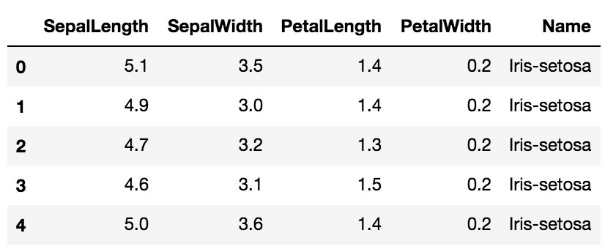
knn
Example1 : Suppose the Famous Iris flower data is used in packages like R, Python. We might get outputs like the following

Slide 9
knn
Height | Weight | T-Shirt Size
158 | 58 | M
158 | 59 | M
158 | 63 | M
160 | 59 | M
160 | 60 | M
163 | 60 | M
163 | 61 | M
160 | 64 | L
163 | 64 | L
165 | 61 | L
165 | 62 | L
165 | 65 | L
168 | 65 | L
168 | 62 | L
168 | 66 | L
170 | 63 | L
170 | 64 | L
170 | 68 | L
161 | 61 | ?
Example3:
Suppose we wish to find out the size of
t shirt of a person based on his height
and weight, based on the following data

Slide 10
knn
Height | Weight | T-Shirt Size | Distance
158 | 58 | M | 4.242641
158 | 59 | M | 3.605551
158 | 63 | M | 3.605551
160 | 59 | M | 2.236068
160 | 60 | M | 1.414214
163 | 60 | M | 2.236068
163 | 61 | M | 2
160 | 64 | L | 3.162278
163 | 64 | L | 3.605551
165 | 61 | L | 4
165 | 62 | L | 4.123106
165 | 65 | L | 5.656854
168 | 65 | L | 8.062258
168 | 62 | L | 7.071068
168 | 66 | L | 8.602325
170 | 63 | L | 9.219544
170 | 64 | L | 9.486833
170 | 68 | L | 11.40175
161 | 61 | ?
Example3:
Suppose we wish to find out the size of
t shirt of a person based on his height
and weight, based on the following data

Slide 11
Good morning

Slide 12
Locally weighted regression
Recall Regression

Slide 13
Locally weighted regression
LWR is a generalization of the knn method.
We chose a Local set, form of regression like linear quadratic etc and then regress using the local set of the query instance.
The phrase "locally weighted regression" is called
local because the function is approximated based a only on data near the query point,
weighted because the contribution of each training example is weighted by its distance from the query point, and
regression because this is the term used widely in the statistical learning community for the problem of approximating real-valued functions.

Slide 14
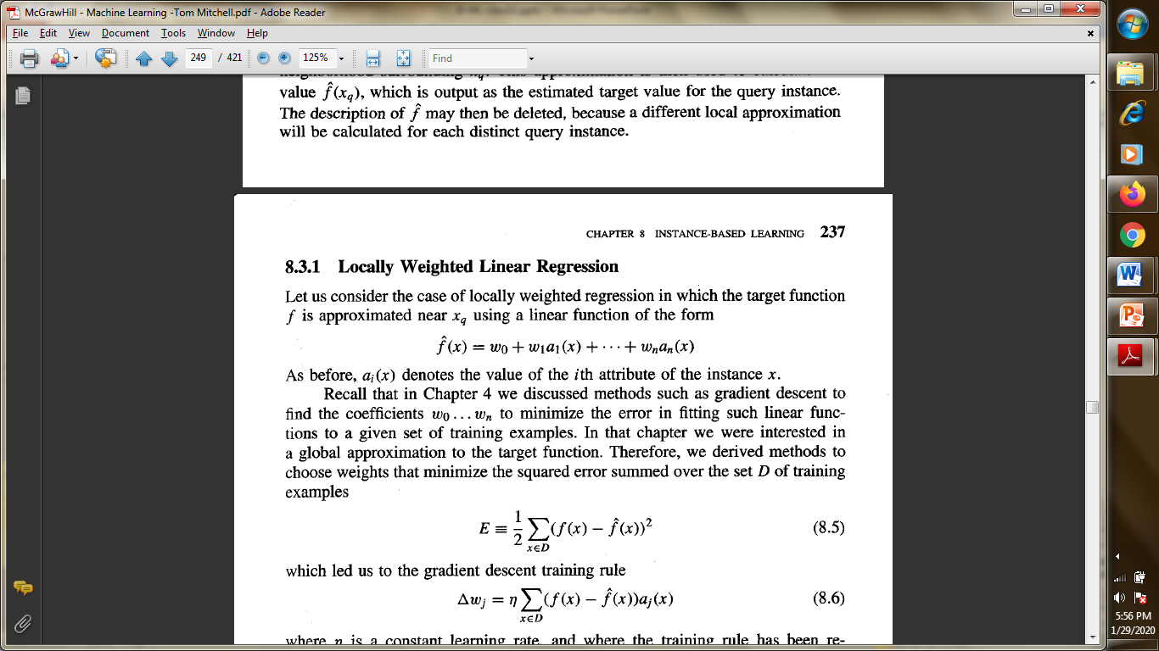
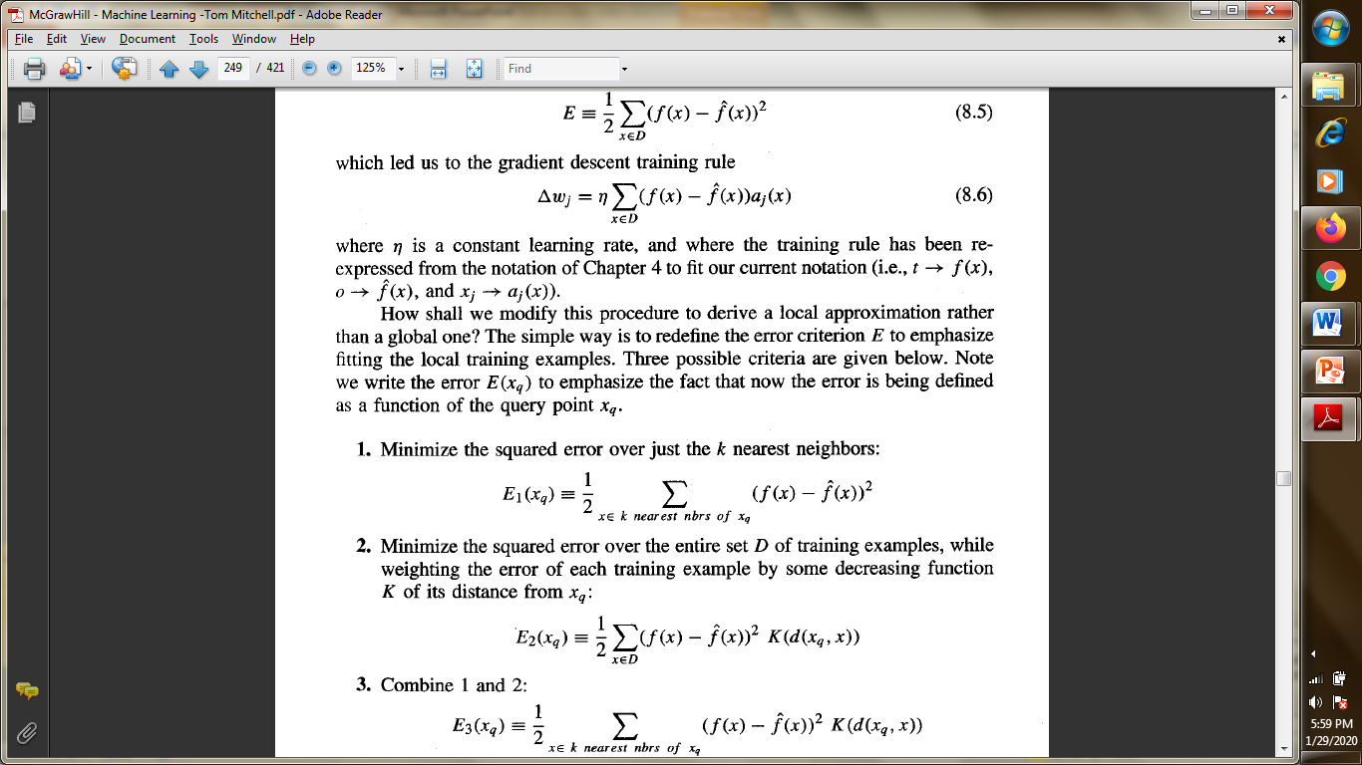
Locally weighted regression
Actually, locally weighted regression in which the target function f is approximated near x, is using a linear function of the form
As before, ai(x) denotes the value of the ith attribute of the instance x and the coefficients wo . . . w, are found using the local set selected which minimizes the error in fitting such linear functions.

Slide 15
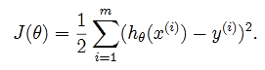
Locally weighted regression
Recall from linear regression, for a given data set (xi,yi), we try to find a function(hypothesis) y such that y=mx+c where m and c are the “parameters” we estimate.
In general we write this as
Our objective is, given a training set, how do we pick, or learn, the parameters θ?
To make h(x) close to y, we define the cost function and minimize it , based on theta.

Slide 16
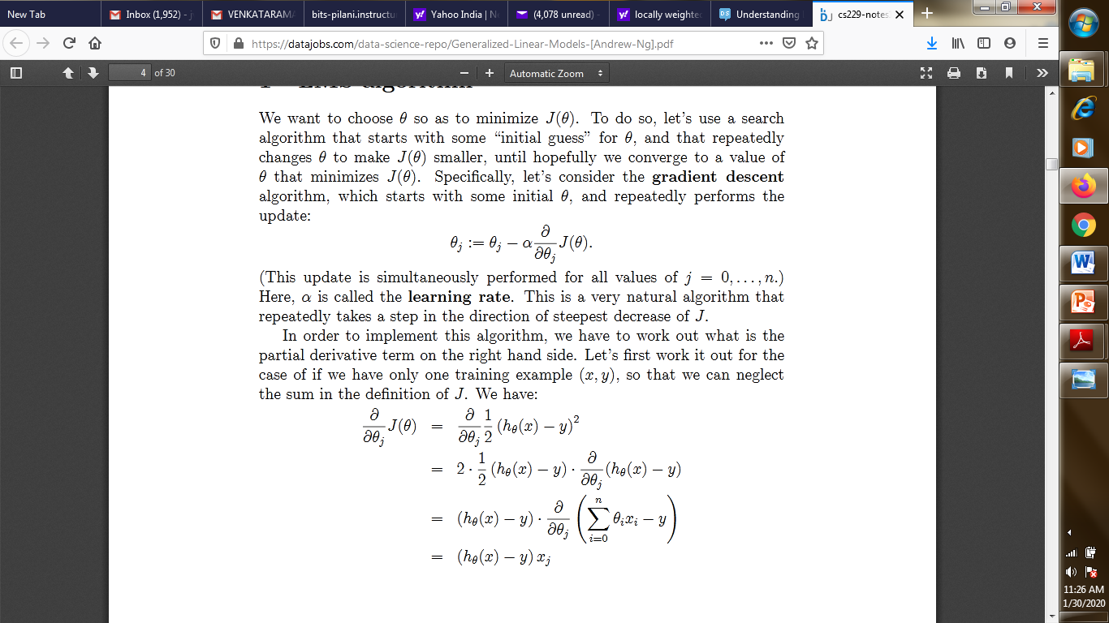
Locally weighted regression
The minimizing of the cost function is using methods like gradient descent.
If we assume, we have a single data point,

Slide 17
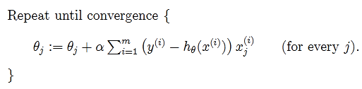
Locally weighted regression
For a general training set of n points, the updating is as per

Slide 18
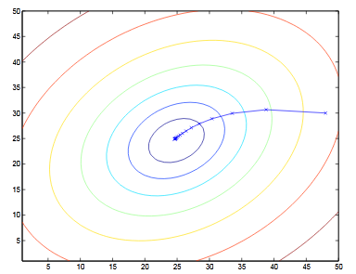
Locally weighted regression
For a data the ellipses shown are the contours of a quadratic function with the trajectory taken by gradient descent, which was initialized at(48,30).

Slide 19
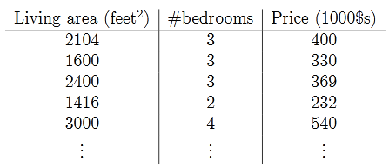
Locally weighted regression
An example of predicting house prices based on area and number of bedrooms,
we obtainθ0= 71.27,θ1= 0.1345. If we plot hθ(x) as a function of x(area), along with the training data, we obtain the following figure

Slide 20
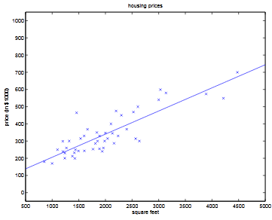
Locally weighted regression
If the number of bedrooms were included as one of the input features as well, we getθ0= 89.60, θ1= 0.1392,θ2=−8.738.

Slide 21
Locally weighted regression
In the original linear regression algorithm, to make a prediction at a query point x(i.e., to evaluate h(x)), we would:
1. Fitθto minimize ∑i(y(i)−θ^{T}x(i))².
2. Outputθ^{T}x.
In contrast, the locally weighted linear regression algorithm does the following:
1. Fitθto minimize ∑iw(i)(y(i)−θ^{T}x(i))².
2. Outputθ^{T}x.

Slide 22
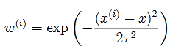
Locally weighted regression
Here, the w(i)’s are non-negative valued weights. Intuitively, if w(i)is large for a particular value of i, then in picking θ, we’ll try hard to make (y(i)−θ^{T}x(i))²small. If w(i)is small, then the (y(i)−θ^{T}x(i))²error term will be pretty much ignored in the fit. A standard choice for the weights is
The Ʈ is called the bandwidth parameter which controls the rate at which the weight changes.
Note that , if|x(i)−x|is small, then w(i)is close to 1; and if|x(i)−x|is large, then w(i)is small.

Slide 23
Locally weighted regression
Let x=5, x¹=4.9 and x²=3. Then the weights are,
The cost function is
We choose Ɵ which minimizes the J .
Note the exponential decrease in the weights based on the distance of the training instances from the query point.

Slide 24
Locally weighted regression
In parametric regression(general) once we estimate theta, we don’t use the data anymore and also we make assumptions about the distributions of the data.
In non-parametric, for every new query x, we calculate theta from a locally distributed data subset. Also , we store the original data for future and there is no assumption about the original data’s distribution.

Slide 25
Good morning

Slide 26
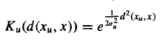
Radial Basis Function
RBF
f'(x)=w₀+ Σ_{u=1}^{k} w_{u} K_{u}(d(x_{u},x))
K_{u}(d(x_{u},x)) is a kernel function that decreases as the distance d(x_{u},x) increases(usually Gaussian)
k is a user-defined constant that specifies the number of kernel functions to be included.
Each kernel is local but the f’ can be global.
A Gaussian kernel is

Slide 27
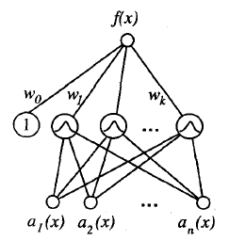
Radial Basis function
The function given by Equation
f'(x)=w₀+ Σ_{u=1}^{k} w_{u} K_{u}(d(x_{u},x))
can be viewed as describing a twolayer network where the first layer of units computes the values of the various K,(d(x,, x)) and where the second layer computes a linear combination of these first-layer unit values.
An example radial basis function
(RBF) network is illustrated in Figure

Slide 28
Radial Basis Function
Given a set of training examples of the target function, RBF networks are typically trained in a two-stage process. First, the number k of hidden units is determined and each hidden unit u is defined by choosing the values of xu and σ²u: that define its kernel function K,(d(x,, x)). Second, the weights w, are trained to maximize the fit of the network to the training data, using the global error criterion . Because the kernel functions are held fixed during this second stage, the linear weight values w, can be trained very efficiently.

Slide 29
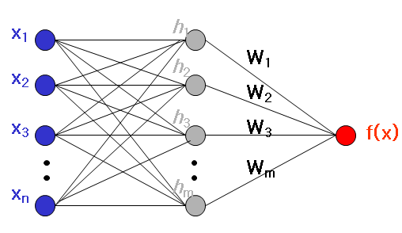
Radial Basis Function network
Approximate function with linear combination of Radial basis functions F(x) = Σ w_{i} h(x)
h(x) is mostly Gaussian function,
h_{j}(x) = exp( -(x-c_{j})² / r_{j}² )
Where c_{j} is center of a region, r_{j} is width of the receptive field

Slide 30
Good morning

Slide 31
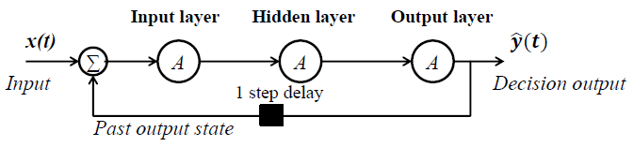
RNN
Simple RNN
Elman RNN

Slide 32
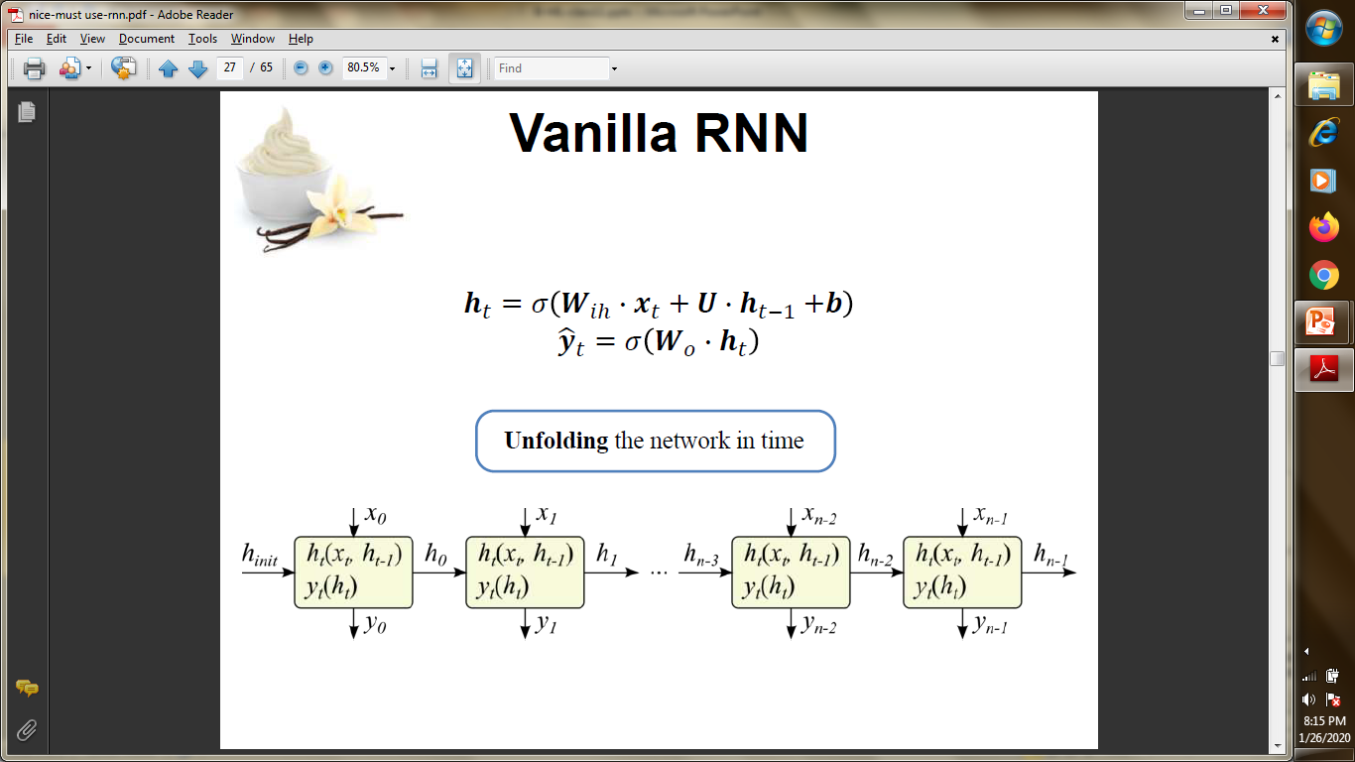
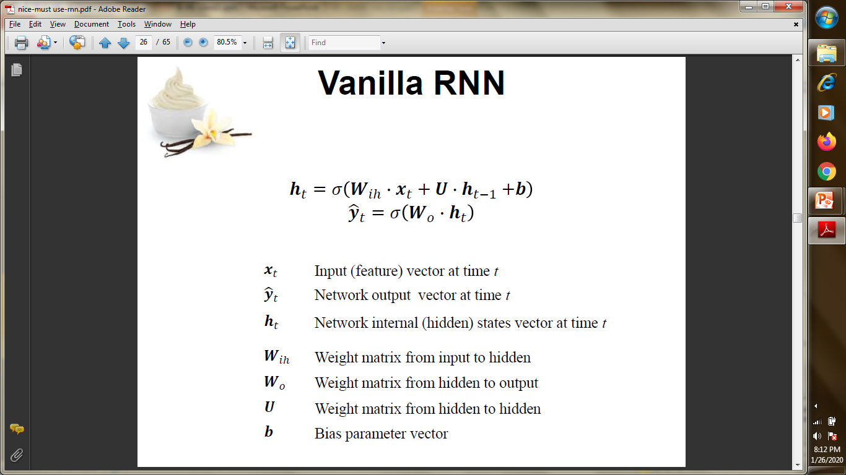
Vanilla RNN
V RNN

Slide 33
Vanilla RNN
X(0) ,as input gives the output h(0) which together with X(1) forms the input for the next step. This continues and hence the current state at time t is

Slide 34
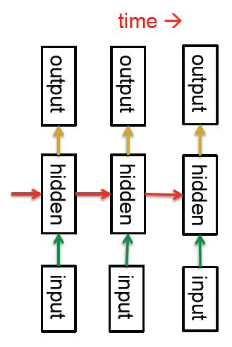
RNN
Looking closely, RNN’s are so, as they have
Distributed hidden states that allow
them to store a lot of information
about the past efficiently.
Activation function will give it the form
as
Whh is the weight at previous hidden state
Whx is the weight at current input state
tanh is the activation function

Slide 35
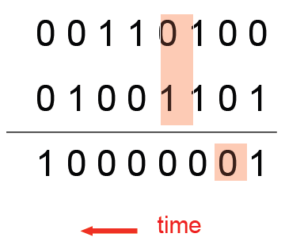
RNN
Inputs are given, output is stored and combines with next input and this cycle continues.
For example Imagine Binary addition. It takes two inputs and provides one output. If it is in recurrence form , then

Slide 36
Good morning

